Slide 1
Biol 7200: Programming for Bioinformatics Loops and control flow, Functions and docstrings

Slide 2
Plan for today
Shebang portability
Loops
Control flow
Functions

Slide 3
Plan for today
Shebang portability
Loops
Control flow
Functions

Slide 4
Using a portable python shebang
As we’ve seen, you sometimes want to use different Python versions
Mamba/Conda environments allow isolation of different versions
Each version’s executable is an environment-specific dir
Hard-coded shebangs restrict your ability to use a desired executable (version) and won’t work on every system

Slide 5
#!/usr/bin/env python3 is portable
A good shebang for Python is #!/usr/bin/env python3
It runs the env command which searches your $PATH for the python3 to use
Instead of hard-coding path to Python, gets it from the environment in which you run the script

Slide 6
Plan for today
Shebang portability
Loops
Control flow
Functions

Slide 7
Loops can iterate over any iterable
Iterable objects are those that support iteration (not everything)
Classes that implement an __iter__() method (more in a later class)
Generator functions – which use the yield statement (more in a later class)
For now, remember that behavior of iteration determined by decisions of code author, not automatic

Slide 8
Some useful iterator functions/methods
Built-in functions
enumerate(iterable) – element and its index in the iterable
range([start,] stop[, step]) – iterate over range of numbers
zip(iterable_1, iterable_2[, …]) – iterate over two or more iterables
reversed(iterable) – reverse order of iterable
Built-in type methods
dict.keys() – same as iterating directly over a dict
dict.values() – iterate over values of dict
dict.items() – iterate over key-value pairs
Standard library modules
itertools.combinations(iterable[, N]) – combinations of elements of iterable, repeated N times
itertools.permutations(iterable[, N]) – permutations of elements of iterable, repeated N times
itertools.product(iterable_1[, iterable_2, …][, repeat= N]) – combinations of elements of one or more iterables, repeated N times

Slide 9
Plan for today
Shebang portability
Loops
Control flow
Functions

Slide 10
Control flow statements modify loop progress
continue – go to next iteration of loop
break – exit loop
pass – do nothing (usually used to satisfy indentation requirement for unimplemented code)

Slide 11
Plan for today
Shebang portability
Loops
Control flow
Functions

Slide 12
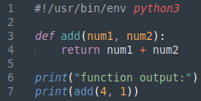

Functions are self-contained blocks of code
Created using keyword def
Can take inputs (positional or keyword)
Can return outputs
Useful when:
Code would otherwise be repeated
Performing a set of operations that form a logical group
Writing self-documenting code

Slide 13

Function definitions have distinct parts
def declares that we are defining a function
The function name comes next (e.g., add)
Inputs are specified in parentheses
Variable names that will be used within the function are specified here
Optional default values can be specified
Indented within the function is the body
Operations performed by function
return statements which return outputs to caller

Slide 14
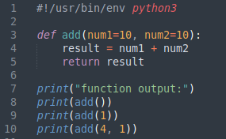

default values make those arguments optional
If defaults are set, then arguments are optional when calling the function
Arguments without defaults must come first in function definition

Slide 15
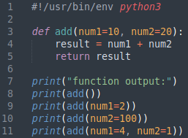
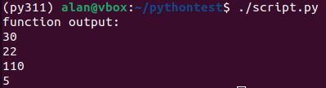
Can provide arguments using keywords
If you provide positional arguments, variables are assigned in order
Argument’s can be provided as <keyword>=<value>
Keyword arguments (“kwargs”) can be provided in any order

Slide 16
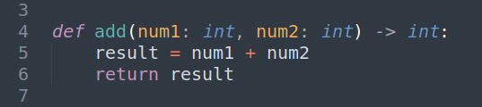
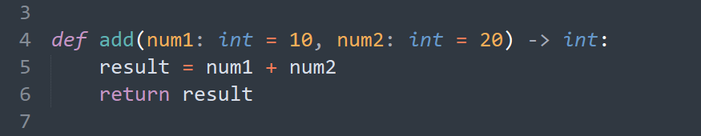
Functions can (should) include type hints
Not required by Python
Good practice, self-documenting code
Not enforced by Python
Python is dynamically typed

Slide 17
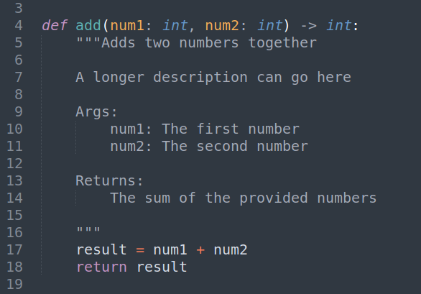
Functions can (should) include docstrings
Docstring is the name of a str which describes a function, its arguments, and its return values
Declared using triple quotes immediately after signature line
Example here uses Google docstring style
Other options (pick your favourite): https://stackoverflow.com/a/24385103

Slide 18
To demo

